Slide 1
Fundamental Technologies Used in PyPy JIT Compiler
PyConJP 2012
Ryotaro Ikeda, 2012/09/06

Slide 2


whoami
Studied about JIT compiler
But, I am now one of working adults (since this April)
And, I was a salesperson (telephone caller) during new graduate’s training
I almost forgot about PyPy! ;-(

Slide 3
Disclaimer
My English is extremely poor
My presentation skill is extremely low
Please feel free to
Ask any question anytime
Leave/Reenter
Of course I can explain in Japanese and English

Slide 4
Today’s topics
What is PyPy?
What is JIT compiler?
What is unique features of PyPy JIT compiler?

Slide 5

Please raise your hand if you know what PyPy is?

Slide 6
PyPy is regarded as …
Faster python implementation
Framework used to develop language implementation
Source-to-source compiler used for RPython
All of them are definitely correct!

Slide 7
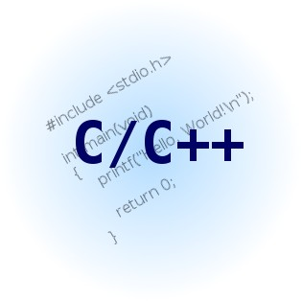
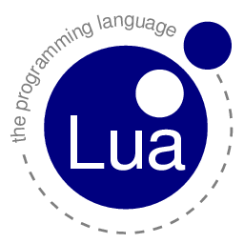


Current woes and PyPy’s goal
Problem
Creating interpreter requires a lot of work
For performance!
Language-based programming
PyPy’s goal
To be able to create interpreter easily
With high-level language like Python
Without giving up performance

Slide 8
Current woes and PyPy’s goal
Problem
Creating interpreter requires a lot of work
Must be programmed in C ,C++
A lot of considering are required to implement language-specific issues
PyPy’s goal
To be able to create interpreter easily
With high-level language like Python
Without giving up

Slide 10
Templates
Problem
Problem

